Slide 1

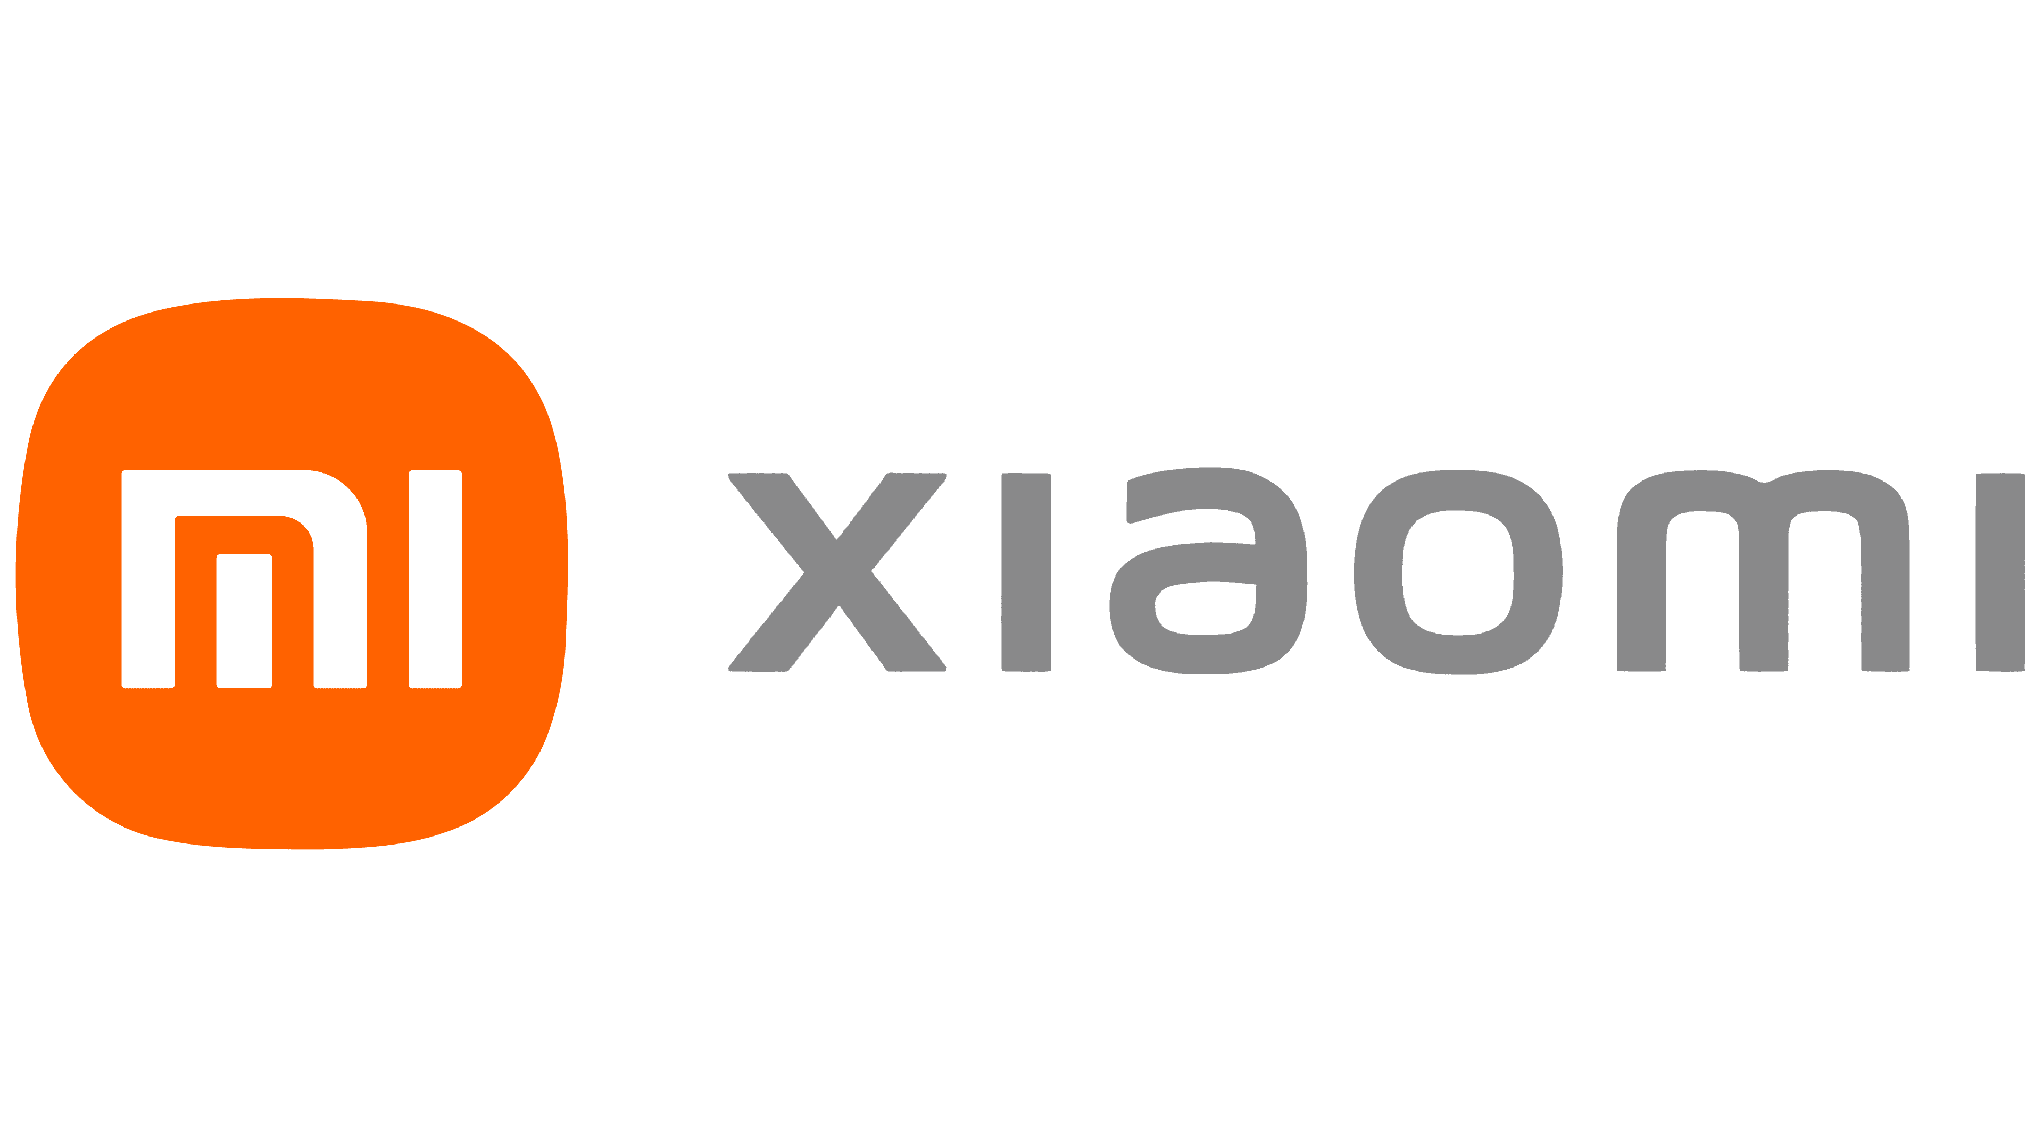





Strategizing A Modern Plan To Establish Market Dominance In The China Smartphone Market
The Xiaomi Dream
Champs!

Slide 2







An overview of how to reignite Xiaomi’s growth in China
How can Xiaomi stand out against its competitors and gain market share in China?
Goal
Expand consumer base in Tier 1-2 cities
Engagement offline in Tier 3-4 cities
Enhance Xiaomi ecosystem
Focus
Smartphones that Care for the Earth
Allying with Local Businesses to Expand Offline
New Ecosystem with Strengthened Aftercare
Solution
Up to CNY 180mn in additional revenues per annum by FY30
SAN
Impact
Introduction
Eco-friendly Phones
Store Expansion
Aftercare
Feasibility
Conclusion

Slide 3




Xiaomi is a prominent player in the China smartphone market, but is facing stagnating revenue as competition intensifies
Company Overview
Declining Growth In China’s Smartphone Market
While smartphones are Xiaomi’s main sales product, the Xiaomi ecosystem offers over 50 categories of smart products which yield higher net margins
Xiaomi’s China market share has been declining since 2015 and this is reflected in decelerating revenue growth from the China market.
Revenue by Country
Xiaomi’s Market Share Has Been Declining Amidst Stronger Competition
Revenue From China Smartphones Is Plateauing
Revenue by Product
39%
8%
62% of Xiaomi’s smartphone sales come from China
*in billion yuan
Unique Selling Points
Strong Customer Loyalty
Factors
Setting up physical stores are expensive and complex
Limited by Xiaomi’s low profit margin sales model
Price-Performance Ratio
Niche Consumer Base
“The Xiaomi Way”
Strong interaction with fans through social media and offline events
Small Offline Presence
The highest concentration of Xiaomi users are
men aged 30-34
Price: Profit margin of smartphones capped at 5%, keeping prices low
Performance: Product improvements based on customer feedback
63.2% current users declared intention to stay true to the brand, highest amongst brands
Difficult to target consumers who prefer to shop for smartphones offline, especially in Tier 3-4 cities
Sources: Globalstats, Statista, QuestMobile, Jiguang Data
Introduction
Eco-friendly Phones
Store Expansion
Aftercare
Feasibility
Conclusion

Slide 4





Our Solution: 创三新 | Creating Three (SAN) Modern Pillars Of Growth For Xiaomi
Using a three-pronged approach, we intend to reach a wider consumer base and create long-term relations with users to boost Xiaomi’s market share in China
1. Smartphones that Care for the Earth
Create a new eco-friendly smartphone series to expand target market in Tier 1-2 cities
SAN
3. New Ecosystem with Strengthened Aftercare
2. Allying with Local Businesses to Expand Offline
Elevate the existing array of ecosystem products to capture customer lifetime value
Increase consumer touchpoints in Tier 3-4 cities in a cost-efficient manner
Introduction
Eco-friendly Phones
Store Expansion
Aftercare
Feasibility
Conclusion

Slide 5


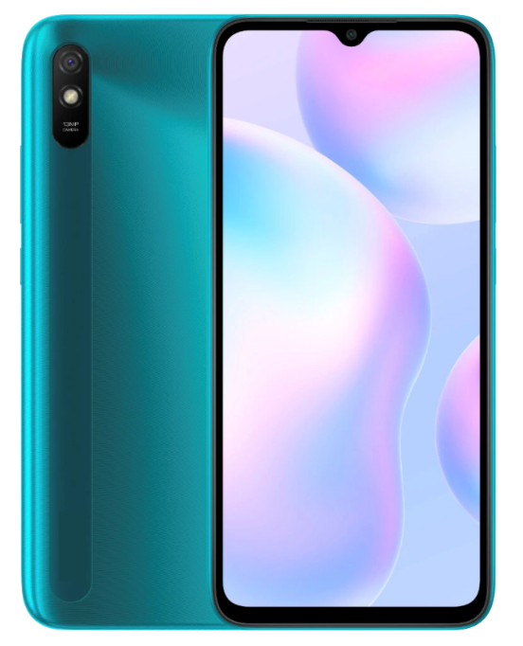






Smartphones that Care for the Earth: Develop a new eco friendly smartphone product line to expand into the untapped environmentally friendly consumer market
Current Market Gaps Identified
Creating An Eco-Friendly Smartphone Line
Led By Gen Zs, Chinese Consumers Are Turning Towards Environmentally Friendly Products
Based on the <2030 Initiative For Sustainable Consumption & Production> report, six focus areas were identified for sustainable smartphone production which Xiaomi can adapt into their new phones
70%
Of Chinese consumers are willing to pay 10% more for sustainable products
Consumers in TIER ONE cities are more likely to shop eco friendly
Design: Eco Series comes with easily replaceable parts and batteries which are affordable
Raw Materials: Use fair trade certified materials which ensure eco-friendly mining and processing methods
Can be easily targeted with Xiaomi’s strong presence in Tier 1 to 2 cities
Production: Increase renewable energy usage to power production. This is aligned with China’s 2030 renewable energy goal
Top Smartphone Brands In China Currently Have Poor Eco-Friendly Ratings, Providing A Market Opportunity For Xiaomi
Usage: Obtain TCO Sustainability Certification which certifies efficient energy consumption of each phone
Eco- Friendly Consumers Currently Do Not Have Viable Smartphone Options
Market Share
Mi Eco Series
Product Length Extension: Use durable materials to ensure longer phone life
Xiaomi should reposition to capture this untapped, growing market
Recycling: Make phones out of recycled plastics and copper to reduce e-waste
Eco-Rating
Sources: Daxue Consulting, Compare And Cycle, Vodafone UK, 2030 Initiative For Sustainable Consumption & Production, Fair Phone
Introduction
Eco-friendly Phones
Store Expansion
Aftercare
Feasibility
Conclusion
Notes:
Tier1 eco: https://daxueconsulting.com/green-products-china/
Eco rating https://www.compareandrecycle.co.uk/blog/what-is-mobile-phones-eco-rating

Slide 6
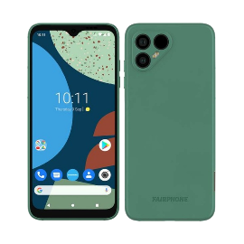






Smartphones that Care for the Earth: Eco-friendly smartphone lines have already shown success in Europe and are aligned with Xiaomi’s cost and price structures
Existing Success Of European Green Phone Makers Show Easy And Feasible Expansion Into A Green Product Line For Xiaomi
Eco-Series Allows Xiaomi To Establish A New USP And Allows It To Reap The Benefits Of A New Target Market
Case Study: Fair Phone – The Most Eco-Friendly Phone Worldwide
Expanding The Target Market
Production Feasibility 56% of phone materials were sourced sustainably in 2020. Included the use of fair trade certified gold, recycled plastic and copper
Tech-Savvy Consumers
Middle-Aged
Men
Gen Zs
Female
Existing Customers
New, Eco-Friendly Customers
Economic Feasibility
Total cost of production per phone was €525
Excluding reselling fees, Europe taxes and applying Xiaomi’s 5% hardware margin, each phone will be priced around CNY 3740, on the higher end of Xiaomi’s phones
Green Initiatives Have Proven To Be Popular And Successful Amongst Consumers
Case Study: Alipay Ant Forest
Alibaba’s Ant Forest initiative rewarded green behaviour by planting trees. Over 500 million users joined, planting a total of 100 million trees, showcasing strong customer receptiveness towards green initiatives.
CNY 2000
11T 5G
Civi
Eco Series
Black Shark LE
Black Shark 4S Pro
CNY 4900
11I
Xiaomi Price Range
Customers will still be receptive because
This line mainly targets wealthier Tier 1 consumers
Market research reveals customers are willing to pay an eco-premium
Eco series is price inelastic as it is the only major eco phone in China
Fair Phone’s Success
Fair Phone sold 95,000 phones in 2020, up 4x from five years ago
Sources: Fair Phone, Xiaomi, Alibaba
Introduction
Eco-friendly Phones
Store Expansion
Aftercare
Feasibility
Conclusion
Notes:
https://unfccc.int/climate-action/momentum-for-change/planetary-health/alipay-ant-forest
https://technode.com/2018/01/26/new-report-shows-differences-between-huawei-users-vs-xiaomi-smartphone-users/

Slide 7




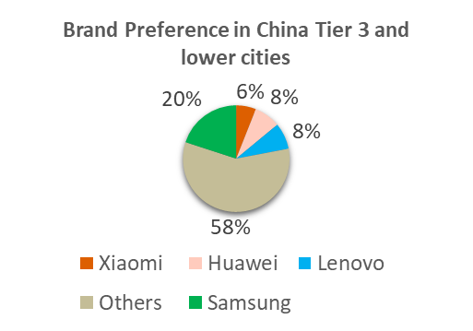



Allying with Local Businesses to Expand Offline: Establish partnerships with local retailers to penetrate lower tier cities while keeping costs low
Current Market Trends Identified
Partnering with existing Brick and Mortar Stores
Lower tier cities are poised to drive overall consumption growth in the country, outstripping tier 1 cities
Lower Tier Cities Have Higher Spending Growth Rates
Xiaomi will partner with top retail chains such as Suning.com and GOME Retail Holding who roughly own 4,400 and 2,600 stores respectively in lower tier cities
Xiaomi will supply products to Suning and GOME's physical retail stores, who will provide display and storage spaces for the products
Average 9.5%
Average 11%
To enhance customer experience, Xiaomi will position trained staff to provide on-the-spot assistance at stores
300% forecasted increase in household consumption from 2017 to 2030 in Tier 3 and lower cities
Xiaomi will obtain an avenue to interact with customers offline without needing to bear the full operating costs of a physical store
However, due to the lack of physical presence in tier 3 and lower cities, Xiaomi is unable to dominate the market in these places
Customers of Tier 3 & 4 Cities
Xiaomi is ranked 4th in preferred brands in Tier 3 cities and below
Sources: Morgan Stanley, McKinsey & Company, Umeng
Introduction
Eco-friendly Phones
Store Expansion
Aftercare
Feasibility
Conclusion

Slide 8


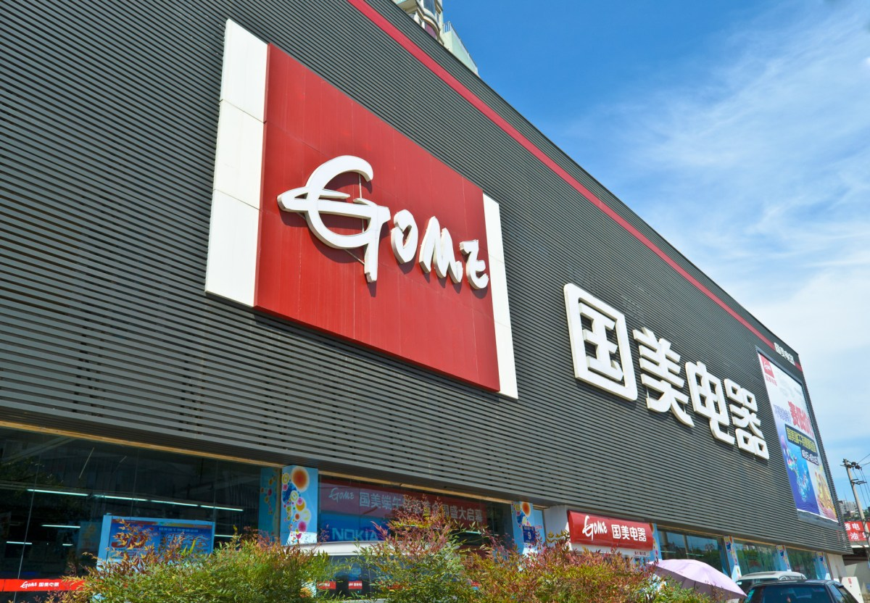



Allying with Local Businesses to Expand Offline: Local partnerships are economically feasible for low margin retailers like Xiaomi and has a proven record
Case Study: Existing Success of Chinese E-commerce retailer JD.com, who invested in local retail chains reflect feasible expansion plan for Xiaomi
Joint Ventures with giant local retail chains allows Xiaomi to reap the benefits of having their products placed in physical stores without burdening themselves with more cost.
Building a network of five million physical stores by 2023 through a mix of its own physical outlets and partnerships with existing retailers like GOME Retail
Economic Feasibility
Xiaomi can enjoy cost savings between 3500-7000 yuan a day per store from not renting their own store
Able to provide more convenient access to products through their large nation-wide network of physical stores
Partnership Feasibility
Suning.com and GOME Retail would be willing to partner with Xiaomi due to its strong branding in China which will bring customers to their stores and potentially increasing revenues from cross selling
Customers can purchase goods online and pick up instore or simply view the item in store and order online for the product to be delivered to them
Market Feasibility
Offline Sales Conversion is almost 4.5 times higher as online. When branded products have physical presence, customers buy between 80-85% of it offline. Customers in tier 3 and 4 cities also prefer to shop for smartphones offline
JD.com net revenues for the third quarter of 2021 were RMB218.7 billion (US$33.9 billion), an increase of 25.5% from the third quarter of 2020
Sources: JD.com, GOME Retail, Oliver Wynman
Introduction
Eco-friendly Phones
Store Expansion
Aftercare
Feasibility
Conclusion

Slide 9



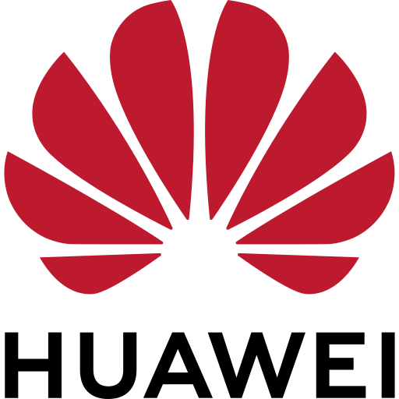
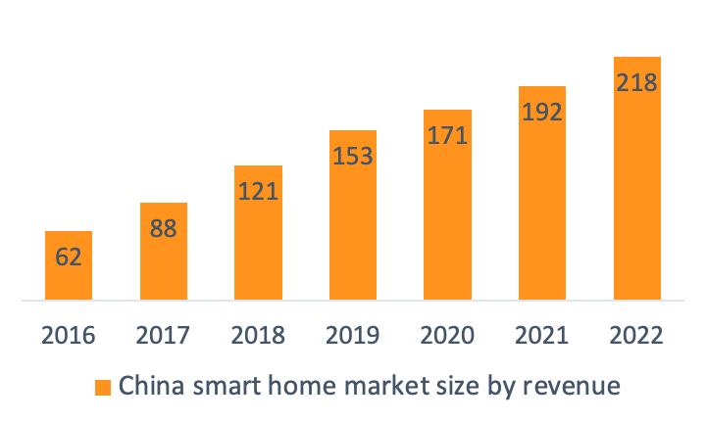




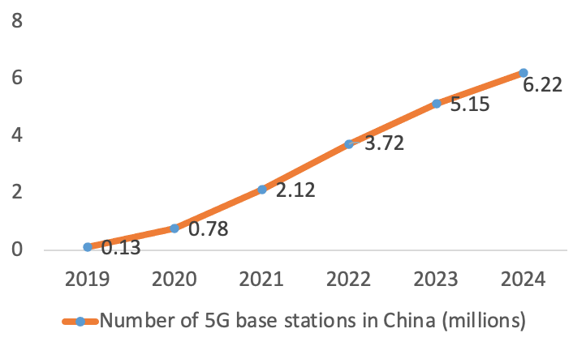








New Ecosystem with Strengthened Aftercare: Further expand Xiaomi’s ecosystem by offering aftercare warranty subscription
Current Market Trends Identified
Implementing a robust aftercare subscription model
23.3% year on year growth indicating continuing growth in the IoT segment
23.3% CAGR
Current process
Purchase
Repair smart product
Product disposal
Purchase
After the warranty is expired and the product is spoilt, Chinese consumers may purchase other Smart home products from competing firms, which may be cheaper or more highly differentiated as no customer loyalty is fostered through incentives or significant savings
Dramatic increases in 5G usage forecasted, providing greater confidence that households will have capacity to transition to Smart homes
Aftercare subscription
Purchase
Repair smart product
Repair or trade
Perpetual value
The warranty can potentially last the lifetime of the customer, and the subscription fees will be perceived by value conscious customers as investments to lengthen the useful life of their favorite products or acquire the latest gadgets at cheaper prices.
47% of customers are more likely to choose a brand if they offer Warranty plans
Subscription based warranties that increase customer savings will increase price-to-value ratio and hence capture customer lifetime value in the rapidly growing smart home market, strengthening the Xiaomi brand name as it builds brand loyalty in everyday products beyond the phone
32% would not make a purchase if a brand did not offer Warranties
Chinese customers are value conscious, and will increase consumption with greater price-to-value ratios
Introduction
Eco-friendly Phones
Store Expansion
Aftercare
Feasibility
Conclusion
Sources: Statista, State Council of China, Mulberry

Slide 10
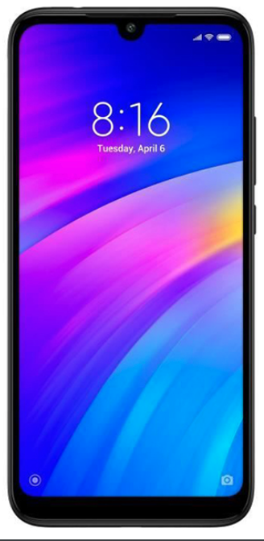

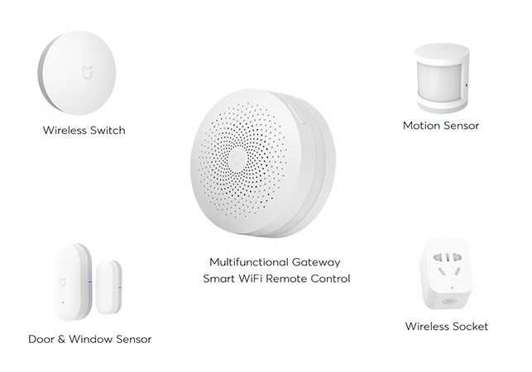



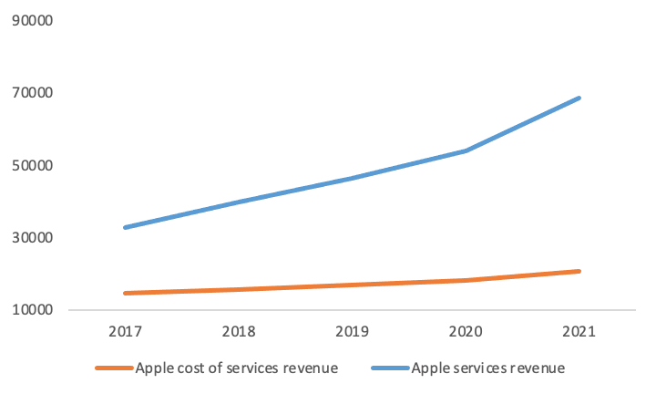





New Ecosystem with Strengthened Aftercare: Subscriptions create a recurring revenue stream and further lock customers into the Xiaomi ecosystem
Xiaomi's ecosystem warranty will increase price-to-value ratio while synergistically creating even stronger Brand Equity with its sustainability message
Apple's success in the field of extended warranties, subscription-based aftercare services, and Grover's success in subscription-based electronics purchase models indicate economic viability
Case Study: Grover
Grover, an electronics company utilizing the subscription model raised 71 million USD in funding recently, indicating interest from investors and viability of the business model
Hi Daniel, select the products you want to extend the warranty for!
Thank you for selecting Xiao Mi, you may choose to trade in your products for newer models or repair them free of charge!
Thank you for using Huawei Ecosystem care, every product returned to us is re-used or disposed of in a safe and sustainable manner!
Case study: Apple
Apple's service revenue margins increased from 0.64 in 2019 to 0.70 in 2021 with increased iPhone sales and further adoption of Applecare+, indicating the profitability and feasibility of an extended warranty / insurance model
Increases in sales will result in increased profitability of services, as cost increases less than proportionately to the revenues generated. Service revenue gross margins have increased by 27%
A year passes
A repair or exchange is made
Customer saves, Xiao Mi gets long term value
Eco-friendly Phones
Sources: CNBC, VIola Fintech, Apple, Xiaomi
Introduction
Store Expansion
Aftercare
Feasibility
Conclusion

Slide 11

Proposed ideas are financially feasible as they bring in huge revenue upside while added costs are short term and can be partially offset by economies of scale
China’s Smartphone Revenue Growth Is Expected To Benefit From The New Eco-Line & Market Share Expansion…
…While After-Care Warranty Subscription Is Set To Bring In CNY60 Bn In Additional Service Revenue By 2030
China has a 1.2 bn consumer population with 70% favorable towards eco-products. A conservative 1% penetration rate at base year equates to 8 million eco-smartphone sales in 2022. This is reasonable given that Xiaomi ships >320 million phones each year.
Apple Care was introduced 10 years ago and hit $8.8 bn revenue in 2021. We expect Xiaomi to achieve similar results in the same time frame given their similar smartphone shipment numbers and Xiaomi’s more extensive accessories/smart home products
Conservative Eco-Line Estimates Yields Stable & Significant Revenue Additions Due To Large TAM
Subscription Revenue To Follow A Similar Growth Rate To Apple
3.7 mn subscribers, the no. of Xiaomi’s current internet services paid users, and an average price of CNY700, slightly below Apple’s was used for 2022 calculations
Operating Expenses Are Expected To Increase In The Near Term But It Is Offset By A Decrease In COGS Due To Scale
Given that China’s smartphone market is only forecasted to grow 1% per annum, successful market share expansion in legacy phone lines in lower tier cities will be Xiaomi’s main revenue driver
Twin Engine Of Market Share Expansion + Eco-Product Line Revitalizes Long Run China Smartphone Growth
Introduction
Eco-friendly Phones
Store Expansion
Aftercare
Feasibility
Conclusion
Notes:
IoT: 25% 2028 https://www.globenewswire.com/news-release/2021/11/10/2331267/0/en/IoT-Market-Size-Share-Growth-Trends-Business-Opportunities-IoT-Companies-Statistics-Report-2028-Internet-of-Things-Industry-Report-Fortune-Business-Insights.html
Global Phone: https://www.businesswire.com/news/home/20200310005411/en/Global-Smartphone-Market-2020-2024-Growing-Adoption-of-AI-in-Smartphones-to-Boost-Growth-Technavio
Av China Phone Price: https://www.statista.com/statistics/1117586/china-average-unit-price-of-5g-smartphone/
Size: https://www.idc.com/getdoc.jsp?containerId=prAP48830922
AppleCAre launched in 2011 hit 8.8b revenue In 10 years or 56 b CNY

Slide 12



In all, the SAN proposal creates numerous long term growth benefits for Xiaomi by increasing TAM and customer engagement while keeping costs in check
In All, Benefits From Proposed Plan Outweigh The Temporary Increase In Costs
Proposals Will Strengthen And Ensure Long Term Top & Bottom Line Growth
Key Revenue & Cost Assumptions
Revenue Growth: For other segments (IoT, normal services, overseas smartphone), industry growth rate was used
12.5% CAGR
Selling & Marketing Expenses % : Forecasted to increase by 200bps in FY22 due to increased personnel & marketing cost from expansion to lower tier cities
R&D Expenses %: Forecasted to increase by 200bps in FY22 and another 200bp to FY25 to reflect additional spend in researching eco-lines
Summary Of Benefits Of The Proposed Plans
S: Smartphones That Care for the Earth
Untapped market opportunity to expand Xiaomi’s TAM. Revenues expected to hit CNY 20 mn by FY30.
COGS %: Forecasted to gradually decrease due to Economies Of Scale. An increase due to eco-friendly materials are not expected as they have a similar cost build to existing phones
Exceeds additional expenses incurred and likelihood of success is high due to strong track record of reference initiatives
A: Allying With Local Businesses
Penetrate into lower tier cities via mutually beneficial partnerships. Market expansion to bring additional revenue of CNY 100 mn revenues by FY30
Up to CNY 180mn in additional revenues per annum by FY30
Long Term Costs %: OpCosts as a % of revenue expected to gradually decrease post FY26 due to scale
N: New Ecosystem With Strengthened Aftercare
Improve network effects, bring in recurring revenue worth CNY 60 mn by FY30
Introduction
Eco-friendly Phones
Store Expansion
Aftercare
Feasibility
Conclusion

Slide 13
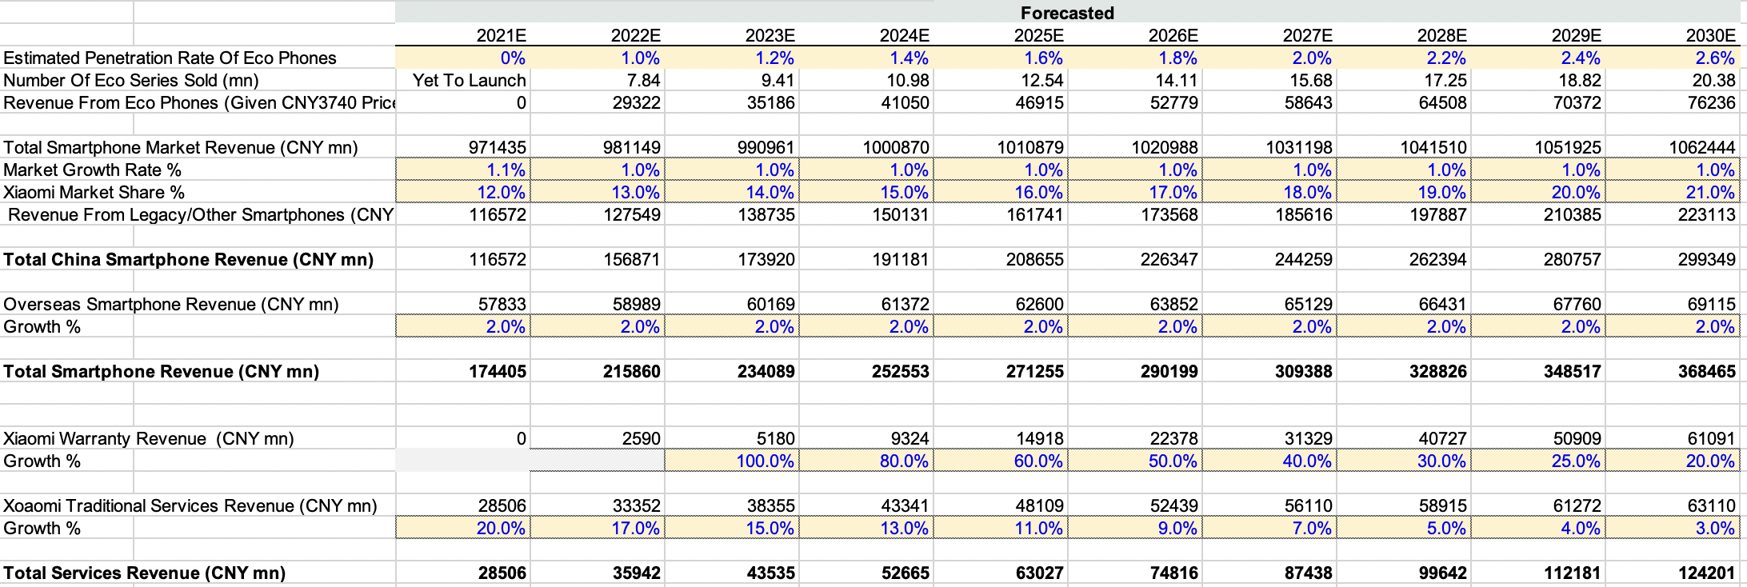
Appendix A: Revenue Model For China Smartphones & Warranty
Assumptions/Key Inputs
Total China Consumer Population (aged 18 & above) = 1.2 bn, 70% of consumers desire eco-friendly products → TAM 784 mn consumers
Penetration Rate * 784 mn = Number Of Eco-Series Sold
Growth Rate for China & Global smartphone markets are taken from IDC & Business Wire
Warranty revenue growth models Apple Care growth
FY22 warranty revenue is derived from 3.7 mn existing Xiaomi services paid users * average price of 700 CNY → This numbers are conservative as Xiaomi ships over 300 mn smartphones a year, hence 3.7 mn subscribers only requires 1% of new buyers to sign up
Traditional Service Revenue growth is stepped down from historical rates

Slide 14
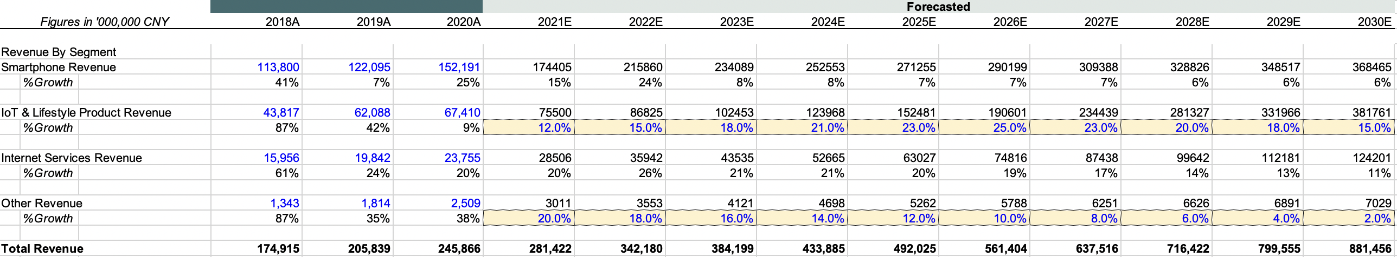
Appendix B: Consolidated Revenue Model
Assumptions/Key Inputs
Smartphone & Services revenue are obtained from Appendix A
IoT revenue is taken from GlobeNewsWire where a CAGR of 25% is expected
Conservatively, we assume that 25% is achieved by 2026 and growth is slowly stepped up till FY26
Stepping up of growth rates from FY20 also reflects steadily returning demand for home/smart products as the pandemic subsides and savings rate start to fall again
Other revenue growth rate is slowly stepped down till 2% which is long term inflation rate

Slide 15
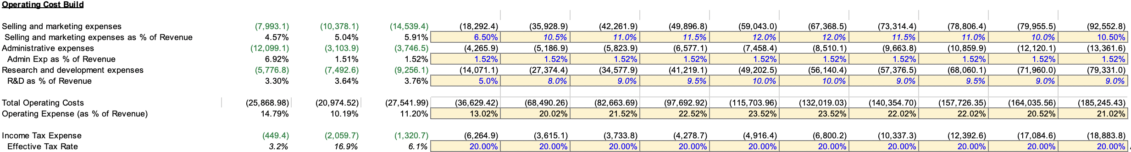
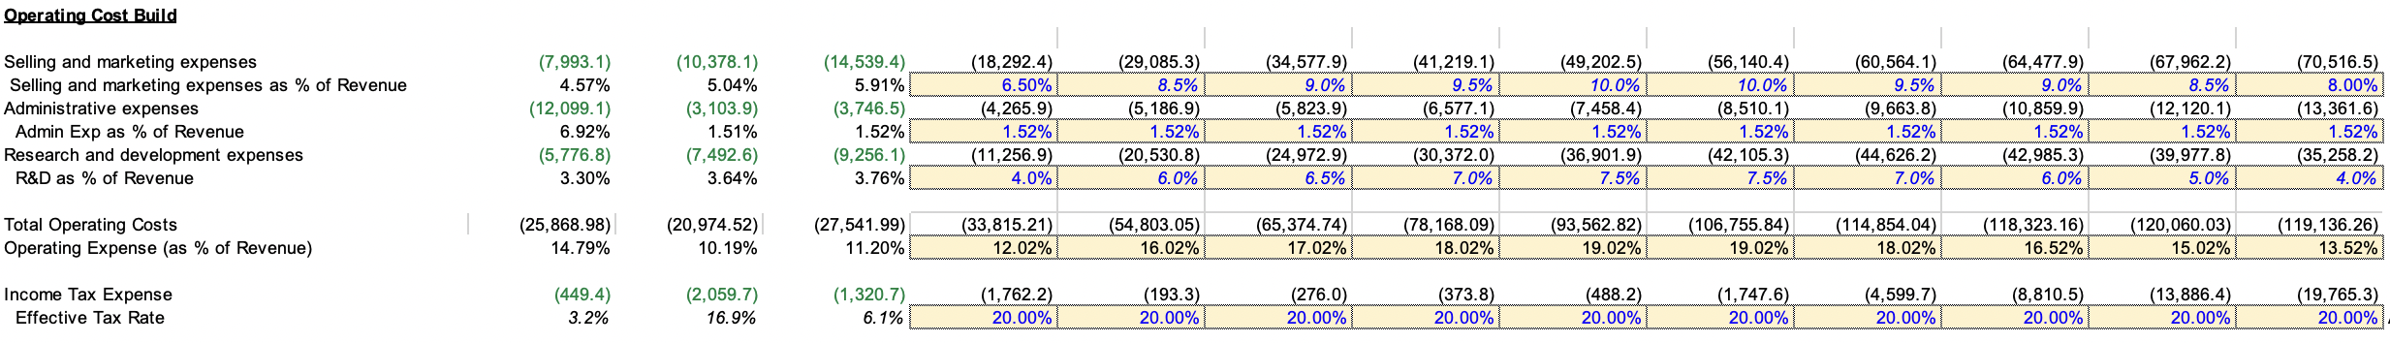
Appendix D: Cost Buildup
Assumptions/Key Inputs
GPM is forecasted to increase as COGS falls due to economies of scale → This has also been reflected in Xiaomi’s past years financials
Eco Phones are not expected to meaningfully increase COGS as Xiaomi’s COGS is already one of the higher among peers
S&M expenses as % of revenue to spike in FY22 due to expansion into lower tier cities → More staff and more marketing required
Admin expense as a % of revenue to remain flat as our expansion plans do not affect admin costs
R&D expenses as a % of revenue to spike in FY22 due to R&D for the eco-product line
Income tax of 20% is an average of the China & global rate

Slide 16
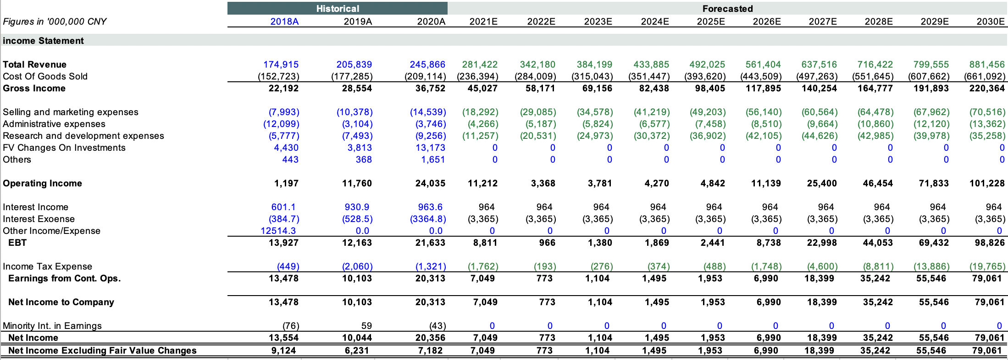
Appendix D: Full Income Statement Projections

